Slide 1
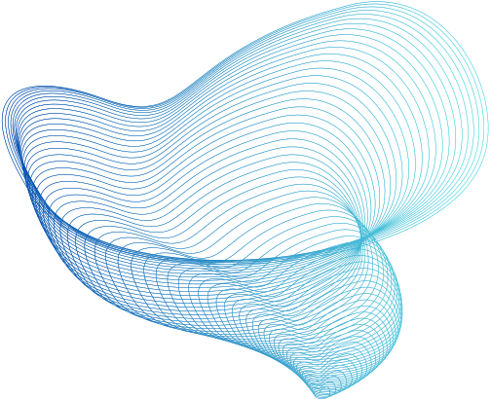

DS-AIBDA
CHAT WITH SCIENTIFIC DOCUMENTS
USING LLMS
Gaurav Boob
42209

Slide 2
PROBLEM STATEMENT
Research and scientific endeavours heavily rely on the analysis and dissemination of information contained within various document formats.
While PDF remains a prevalent format for sharing research findings, scientists, academics, and professionals often utilize a diverse array of formats such as DOC, DOCX, TEX, and PPT for creating and presenting their work.
However, existing solutions primarily cater to parsing PDF documents, leaving a gap in efficiently handling these alternative formats.

Slide 3
INTRODUCTION
Documents are fundamental to research and professional communication, but existing solutions primarily focus on parsing PDF files. This leaves a gap in handling diverse formats like DOCX, TEX, and PPT, hindering efficient information extraction.
Our project aims to develop a robust framework to parse multiple formats beyond PDF, integrated with language models for intuitive user interaction and query answering.
This will streamline document analysis and knowledge dissemination, fostering a more efficient ecosystem for research and collaboration.

Slide 4

USE-CASES OF LLMS
LLMS can be used to analyze large datasets in scientific research.
It can help identify patterns, correlations, and trends in the data.
DATA ANALYSIS
LLMS can assist in designing experiments for scientific research.
It can help determine the appropriate sample size, control variables, and experimental conditions.
EXPERIMENTAL DESIGN
LLMS can streamline the process of conducting a literature review.
It can help researchers find relevant articles, extract key information, and organize references.
LITERATURE REVIEW
LLMS can facilitate collaboration among researchers in scientific research.
It can provide a centralized platform for sharing data, documents, and findings.
COLLABORATION

Slide 5
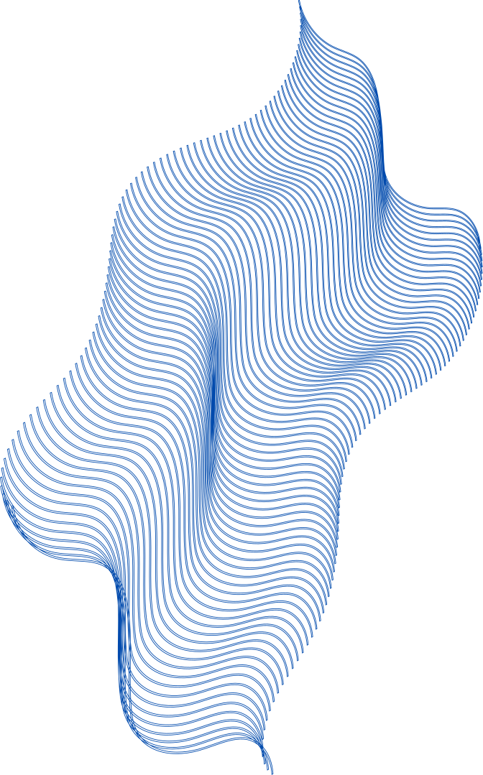
APPROACH
Document Parsing and Preprocessing:
For text files (.txt), straightforward reading can be done using Python's built-in file handling.
For PowerPoint (.pptx) and Pdf (.pdf) files, we have used Convert-api.
Utilised libraries such as docx for parsing data from a docx file.
for latex (.tex) files we are sending the code to the model.
Preprocess the extracted text data to remove any irrelevant information, such as metadata , formatting artefacts or stop words.
Language Model Integration:
Integrated Gemini 1.0 Pro, my chosen language model, for natural language understanding tasks and processing user queries.

Slide 6
APPROACH
User Interface Development:
Developed a web-based interface using Streamlit and Django frameworks to provide a user-friendly experience.
Used tiktoken for authentication and authorization functionalities if required.
Implemented interactive features allowing users to upload documents and input queries.
Document Analysis and Query Answering:
Used Gemini 1.0 Pro for document analysis, extracting key insights, generating summaries and answering users query.

Slide 7
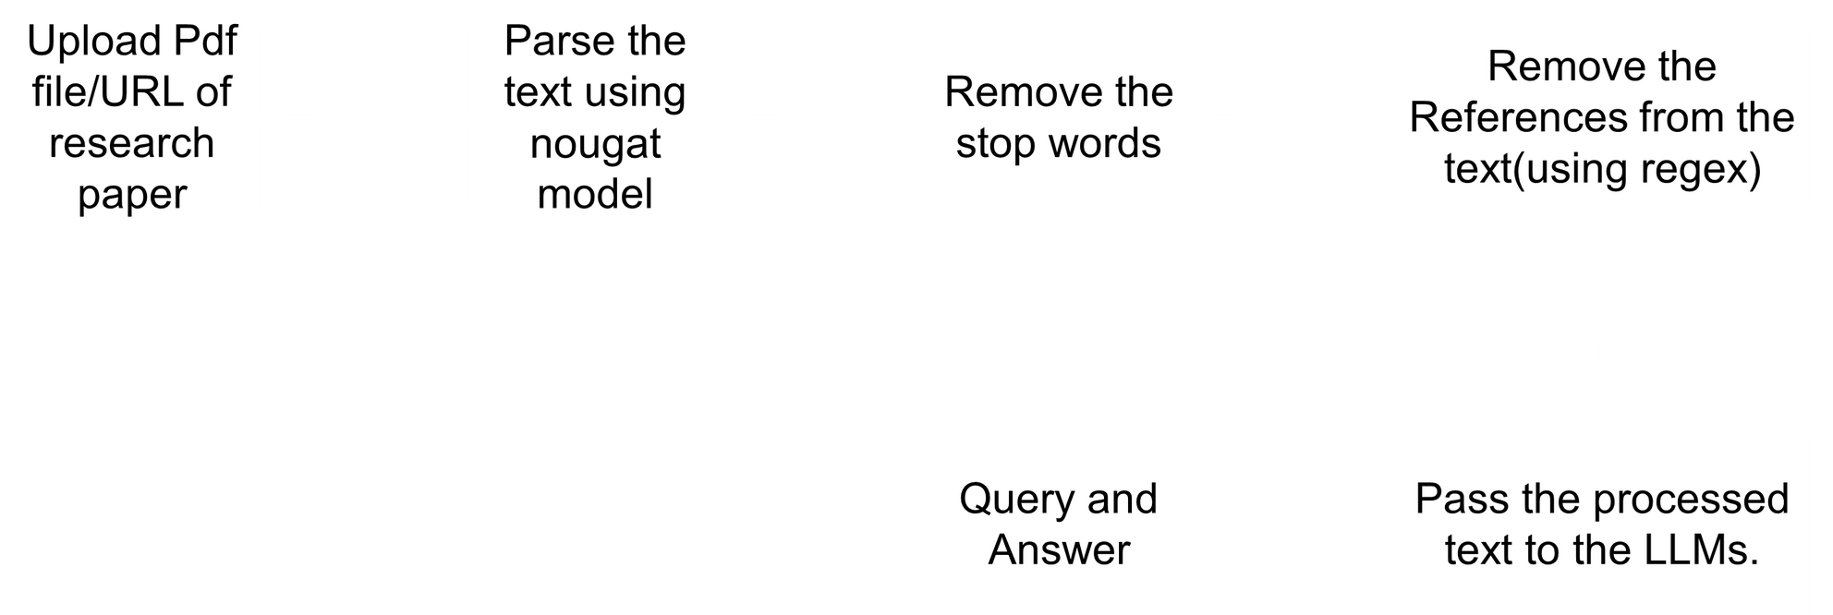

NOUGAT PIPELINE FLOW

Slide 8

Efficient Research
LLMS allows researchers to quickly find relevant information within scientific documents through chat-based queries.
01
Natural Language Understanding
With LLMS, users can converse with scientific documents using natural language, making it easier to understand complex concepts.
02
ADVANTAGES
Collaboration and Knowledge Sharing
LLMS enables seamless collaboration and knowledge sharing among researchers, allowing them to discuss and exchange ideas directly within the documents.
03
Time-saving
By chatting with scientific documents, researchers can save time by quickly extracting key information instead of manually searching through lengthy documents.
04

Slide 9



WHY SHOULD YOU CHOOSE THIS SOLUTION?
Comprehensive Format Support
This solution offers support for a wide range of document formats, including PDF, TXT, PPTX,Tex and DOCX. This ensures versatility and flexibility, allowing users to work with documents in their preferred formats without constraints
Advanced Language Model Integration
Integratation of Gemini 1.0 Pro, a powerful language model, into the solution enables advanced natural language understanding capabilities, including document analysis, summarization, and query answering. Users can leverage Gemini 1.0 Pro to gain valuable insights from their documents quickly and accurately.
User-Friendly Interface
The solution features a user-friendly web-based interface developed using Streamlit and Django frameworks. This interface makes it easy for users to upload documents, input queries, and interact with the system seamlessly. The intuitive design enhances user experience and productivity.

Slide 10
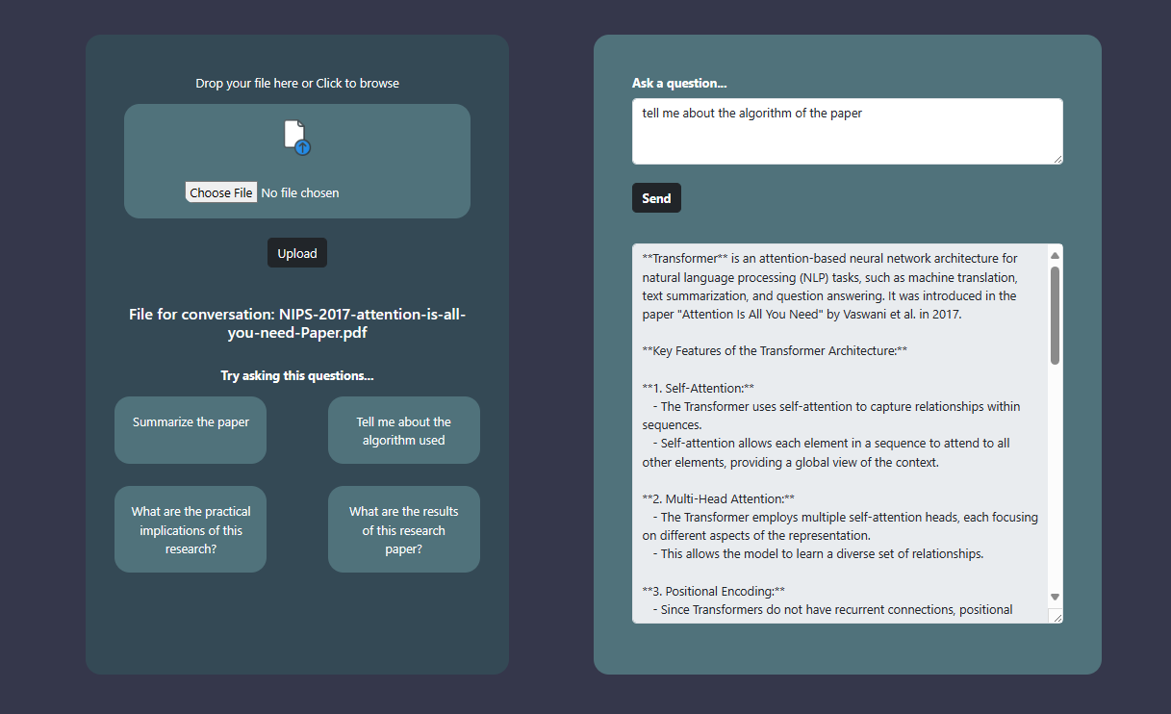
UI DESIGN

Slide 11
THANK YOU

